Slide 1
PRJECT BUSINESS CASE
IT Project Management Foundation

Slide 2
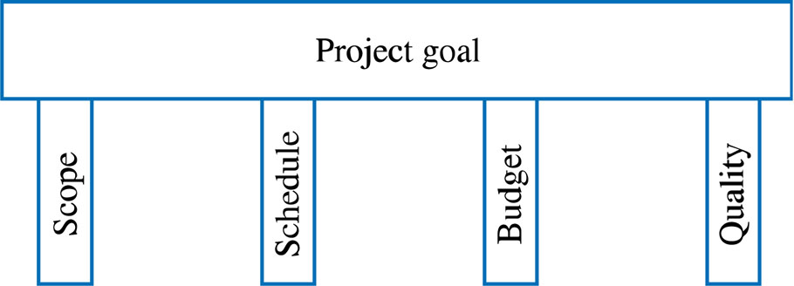
IT Project Management Foundation
Project Management Processes
  Initiating processes
  Planning processes
  Executing processes
  Controlling processes
  Closing processes
Project Objectives

Slide 3
What is a Business Case ?
Definition: a Business case is an analysis of the organizational value, feasibility, costs, benefits and risks of the project plan.
Attributes of a good Business Case:
  Details all possible impacts, costs, benefits
  Clearly compares alternatives
  Objectively includes all pertinent information
  Systematic in terms of summarizing findings

Slide 4
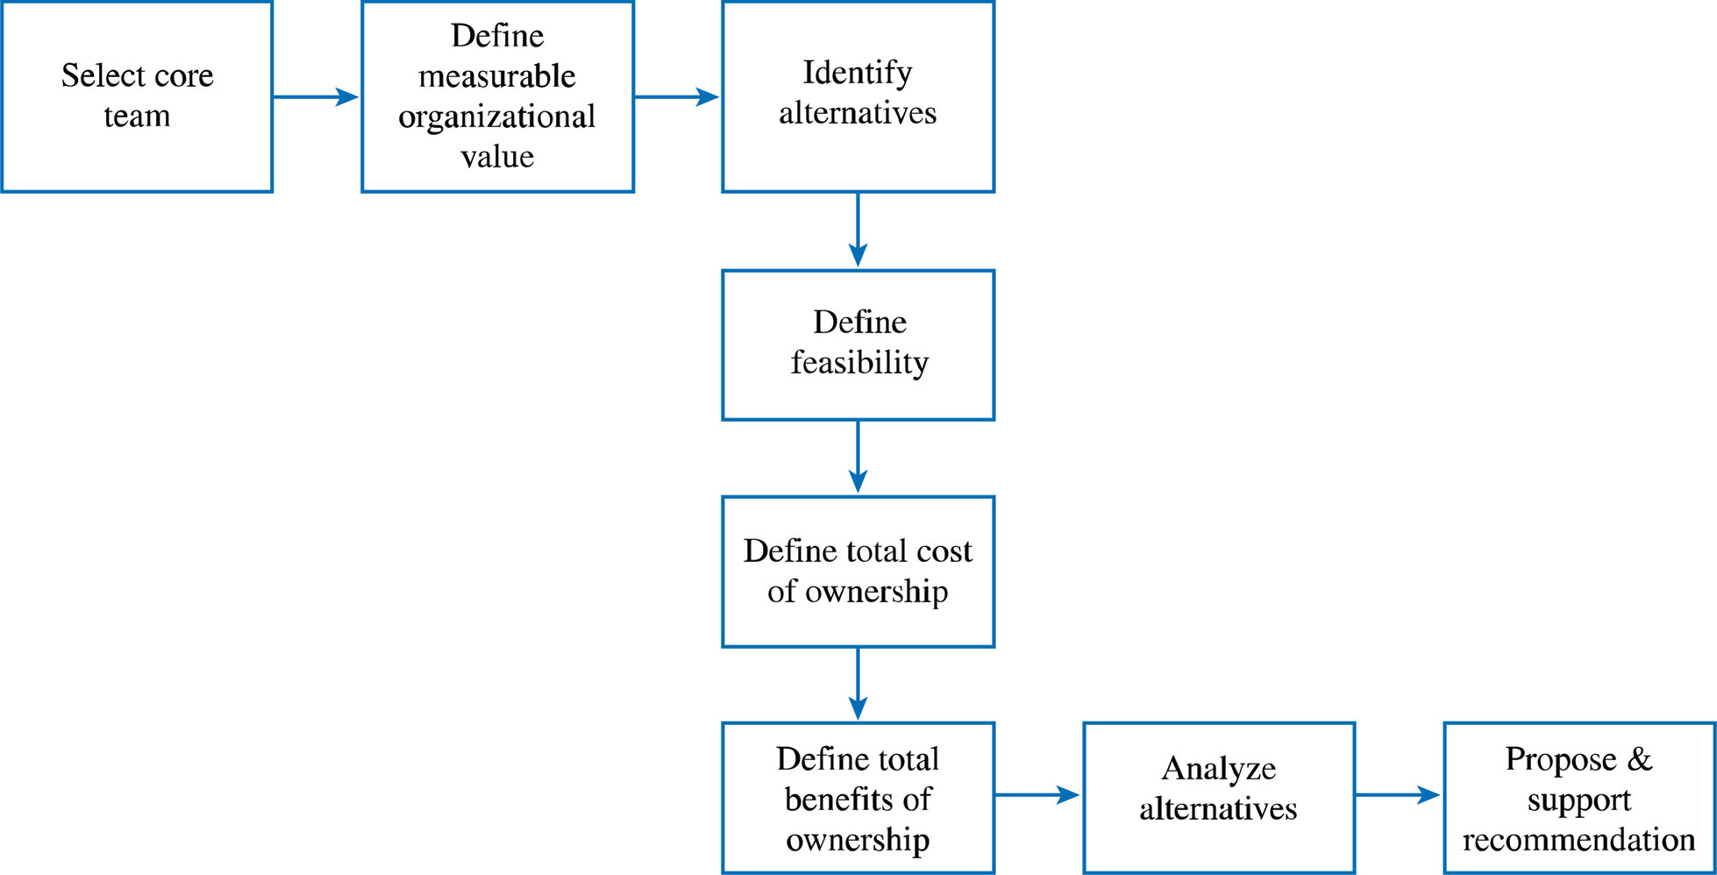
Process for Developing the Business Case

Slide 5
Developing the Business Case
Step 1: Select the Core Team
Advantages:
    Credibility
    Alignment with organizational goals
    Access to the real costs
    Ownership
    Agreement
    Bridge building

Slide 6
Developing the Business Case
Step 2: Define Measurable Organizational Value (MOV) - the project’s overall goal.

Slide 7
Measurable Organizational Value (MOV)
The project’s goal
Measure of success
Must be measurable
Provides value to the organization
Must be agreed upon
Must be verifiable at the end of the project
Guides the project throughout its life cycle
Should align with the organization’s strategy and goals

Slide 8
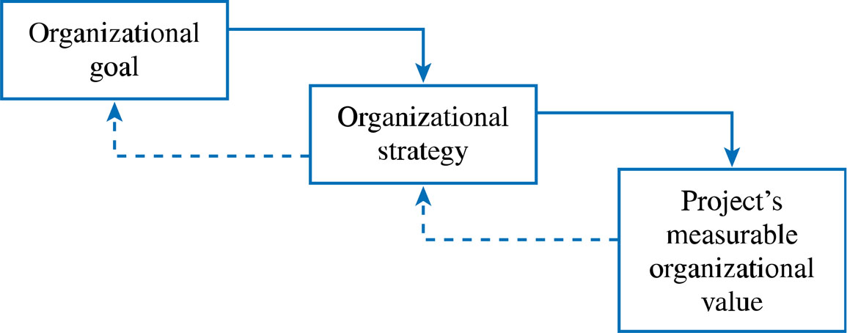
The IT Value Chain

Slide 9
Process for Developing the MOV
I. Identify the desired area of impact
Potential Areas:
Strategic
Customer
Financial
Operational
Social

Slide 10
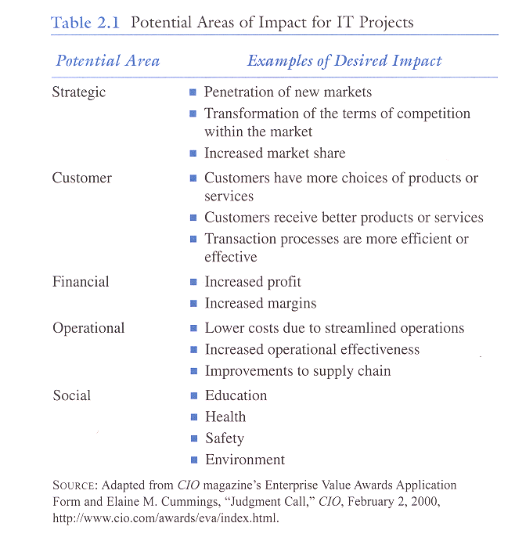

Slide 11
Process for Developing the MOV cont’d
II. Identify the desired value of the IT project
Organizational Value:
Better?
Faster?
Cheaper?
Do More? (growth)

Slide 12
Process for Developing the MOV cont’d
III. Develop an Appropriate Metric
      Should it increase or decrease?
Metrics:
Money ($ £ etc. )
Percentage (%)
Numeric Values

Slide 13
Process for Developing the MOV cont’d
IV. Set a time frame for achieving the MOV
    When will the MOV be achieved?

Slide 14
Process for Developing the MOV cont’d
V. Verify and get agreement from the project stakeholders
  Project manager and team can only guide the process

Slide 15
Process for Developing the MOV cont’d
VI. Summarize the MOV in a clear, concise statement or table.
This project will be successful if _________________.
MOV: The B2C project will provide a 20% return on
investment and 500 new customers within the
first year of its operation

Slide 16
Year | MOV
1 | 20% return on investment 500 new customers
2 | 25% return on investment 1,000 new customers
3 | 30% return on investment 1,500 new customers
Example MOV Using Table Format

Slide 17
Exercise: Project Goal ?
Install new hardware and software to improve our customer service to world class levels.
Respond to 95% of our customers’ inquiries within 90 seconds with less than 5% callbacks about the same problem.
versus

Slide 18
A Really Good Goal
Our goal is to land a man on the moon and return him safely by the end of the decade.
John F. Kennedy

Slide 19
Developing the Business Case
Step 3: Identify Alternatives
  Business Case Alternative
  Possible Alternative Strategies for example:
    Change existing process without investing in IT
    Adopt/Adapt systems from other organizational areas
    Reengineer Existing System
    Purchase off-the-shelf Applications package
    Custom Build New Solution

Slide 20
Developing the Business Case
Step 4: Define Feasibility and Asses Risk
  Economic feasibility
  Technical feasibility
  Organizational feasibility
  Other feasibilities
  Risk focus on:
  Identification
  Assessment
  Response

Slide 21
Developing the Business Case
Step 5: Define Total Cost of Ownership
  Direct or Up-front costs
  Ongoing Costs
  Indirect Costs

Slide 22
Developing the Business Case
Step 6: Define Total Benefits of Ownership
  Increasing high-value work
  Improving accuracy and efficiency
  Improving decision-making
  Improving customer service

Slide 23
Developing the Business Case
Step 7: Analyze Alternatives using financial models and scoring models
  Payback
  NPV
  ROI
  Weighted score
  SWOT
  Balanced scorecard

Slide 24
Developing the Business Case
Step 8: Propose and Support the Recommendation

Slide 25
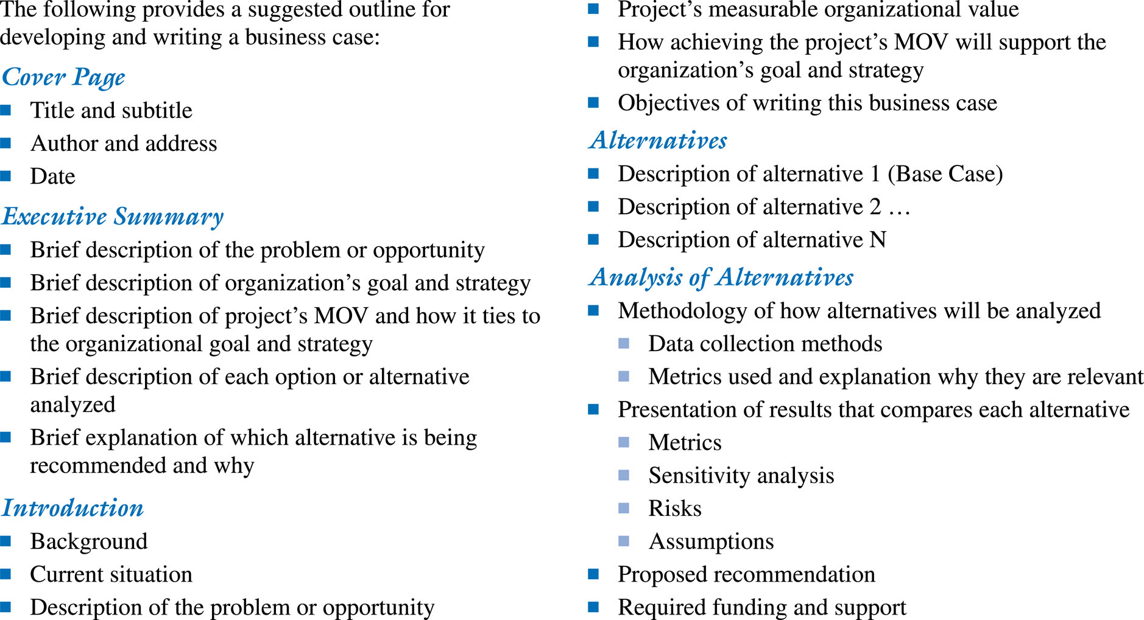
Business Case Template

Slide 26
Project Selection and Approval
The IT Project Selection Process
The Project Selection Decision
  IT project must map to organization goals
  IT project must provide verifiable MOV
  Selection should be based on diverse measures such as
    tangible and intangible costs and benefits
    various levels throughout the organization

Slide 27
        END!

